Slide 1
Major US Oil and Gas Stock Price EDA
A Comprehensive Analysis of Stock Prices of Major US Oil and Gas Companies
SULAIMAN BAH

Slide 2
INTRODUCTION
OBJECTIVE :
Perform Exploratory Data Analysis (EDA) on the stock prices of major US oil and gas companies.
Identify trends, correlations, and potential outliers.
COMPANIES ANALYZED:
XOM: Exxon Mobil Corporation
CVX: Chevron Corporation
COP: ConocoPhillips
MPC: Marathon Petroleum Corporation
PSX: Phillips 66
VLO: Valero Energy Corporation
MRO: Marathon Oil Corporation
SLB: Schlumberger Limited

Slide 3
DATA OVERVIEW
Dataset Source: Stock price data of major US oil and gas companies.
Data points: Date, Symbol, Open, High, Low, Close, Volume, etc.
Data Characteristics: Total Records, Data range, Number of companies.
Data Integrity: Missing values, Data types, Unique values.
Summary Statistics
Exploratory Analysis Focus: Trend Analysis, Volume Analysis, Comparison.
Future predictions.

Slide 4
INITIAL DATA INSPECTION
Steps Performed:
Loaded the dataset and inspected the structure using df.head(), df.tail(), df.info(), and df.describe().
Checked for missing data, duplicates, and data types.
Key Observations:
No missing data found.
Data types were consistent with expectations.

Slide 5
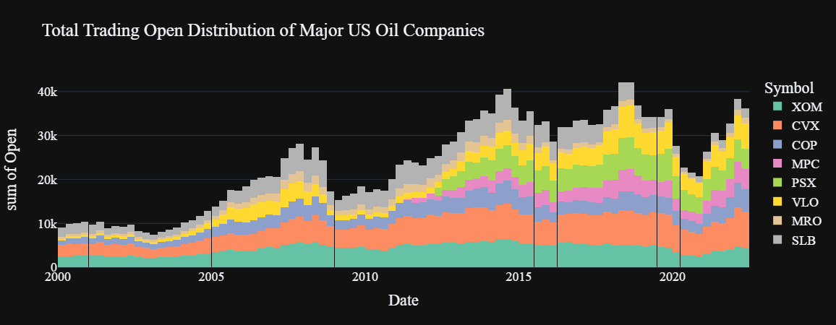
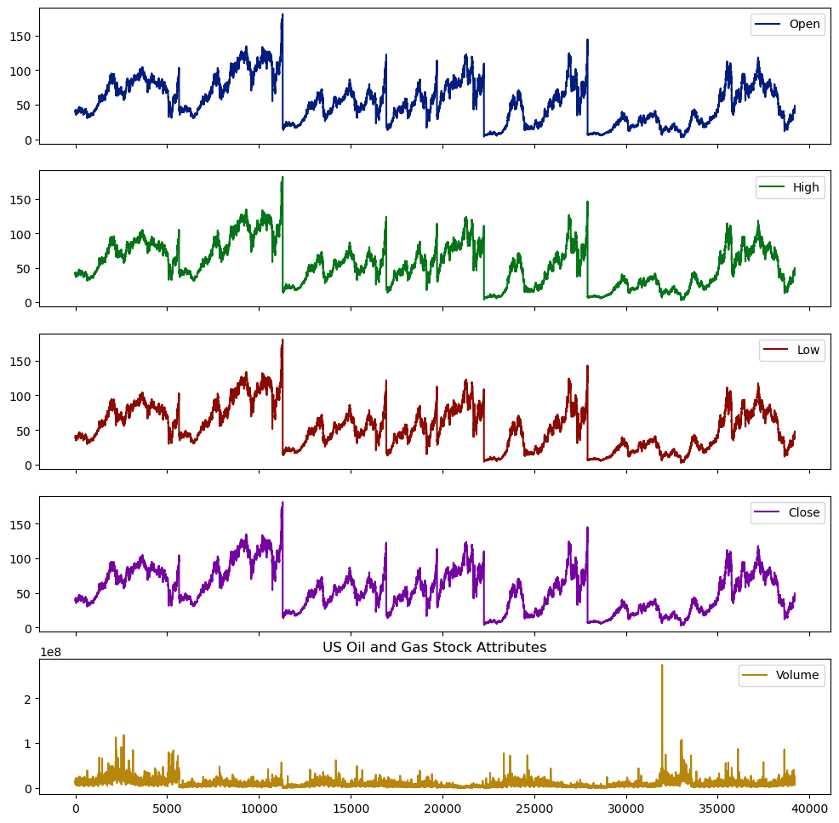
VISUALIZING STOCK TRADING DATA
Histograms:
Distribution of Open, High, and Volume for each company over time.
Insight: Identified periods of higher trading volumes and price spikes.
Subplots:
Plotted all attributes to quickly inspect trends.
Insight: Observed general upward/downward trends in stock prices.

Slide 6
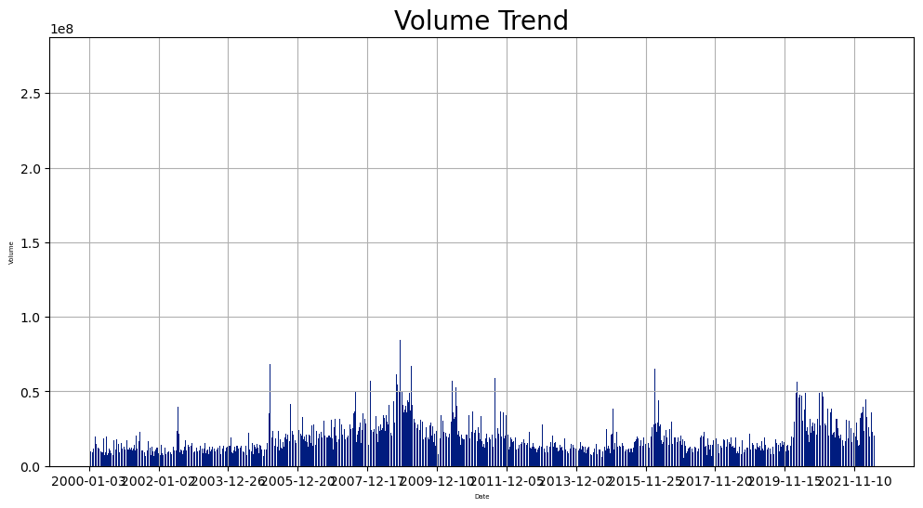
VOLUME TREND ANALYSIS
Bar Plot: Visualized the trend of trading volume over time.
Insight: Notable spikes in volume during significant market events.

Slide 7
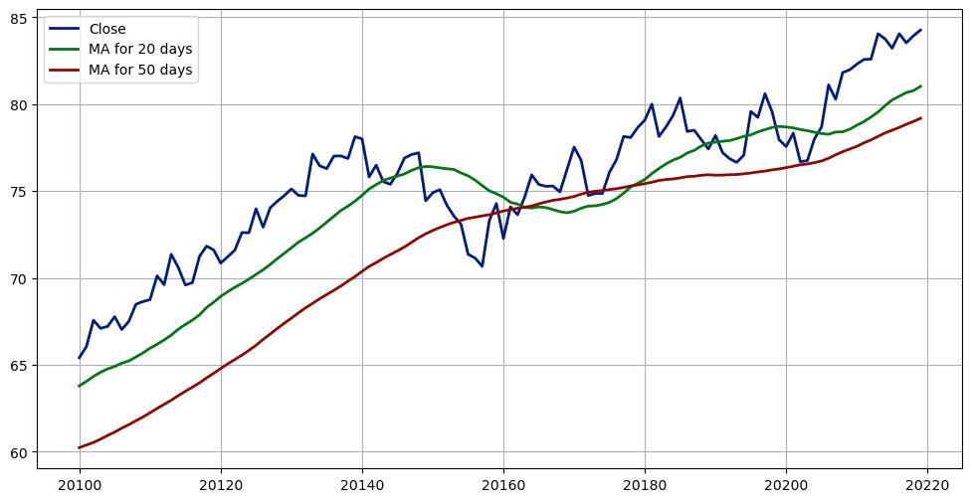
MOVING AVERAGES
Moving Averages Calculation:
20-day and 50-day moving averages of the opening prices.
Visualization:
Compare the moving averages with the actual closing prices.
Insight: Identified periods where the stock was overbought or oversold.

Slide 8
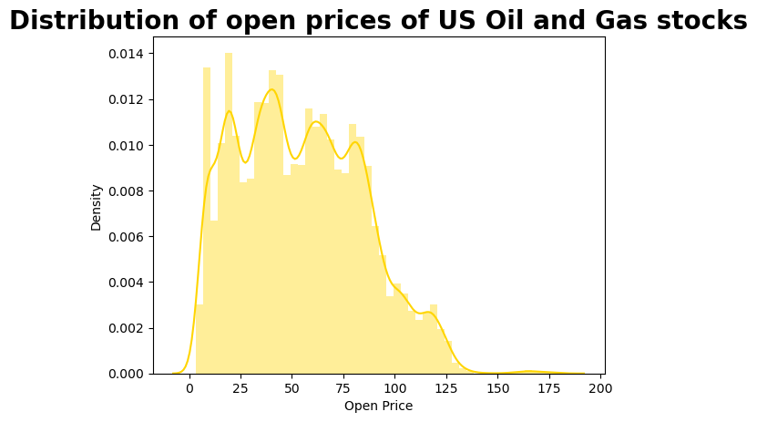
DISTRIBUTION OF OPENING PRICES
Seaborn Distribution Plot: Distribution of opening prices across the dataset.
Insight: Skewness towards certain price ranges indicating market behavior.

Slide 9
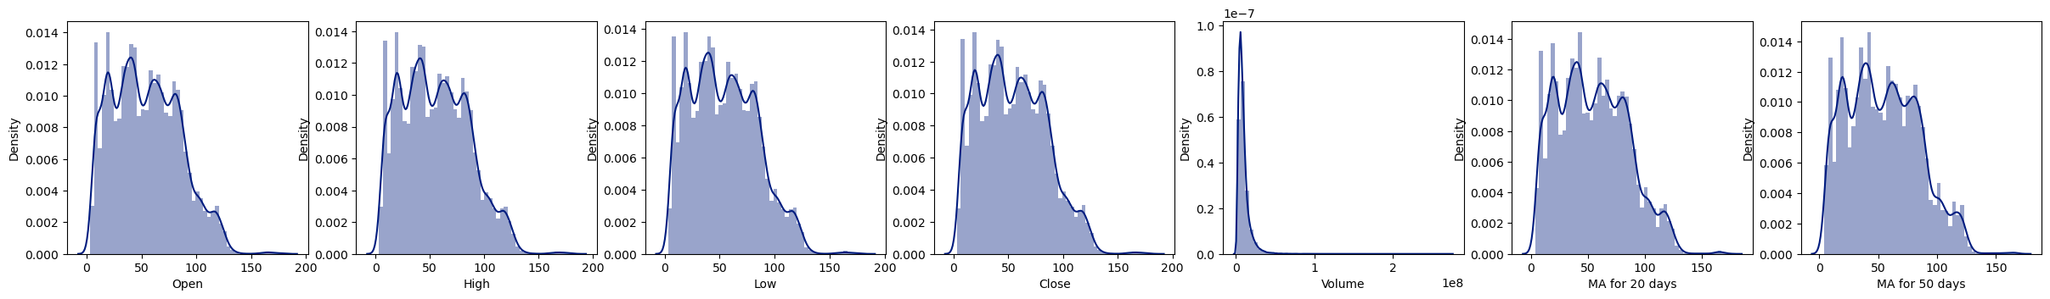
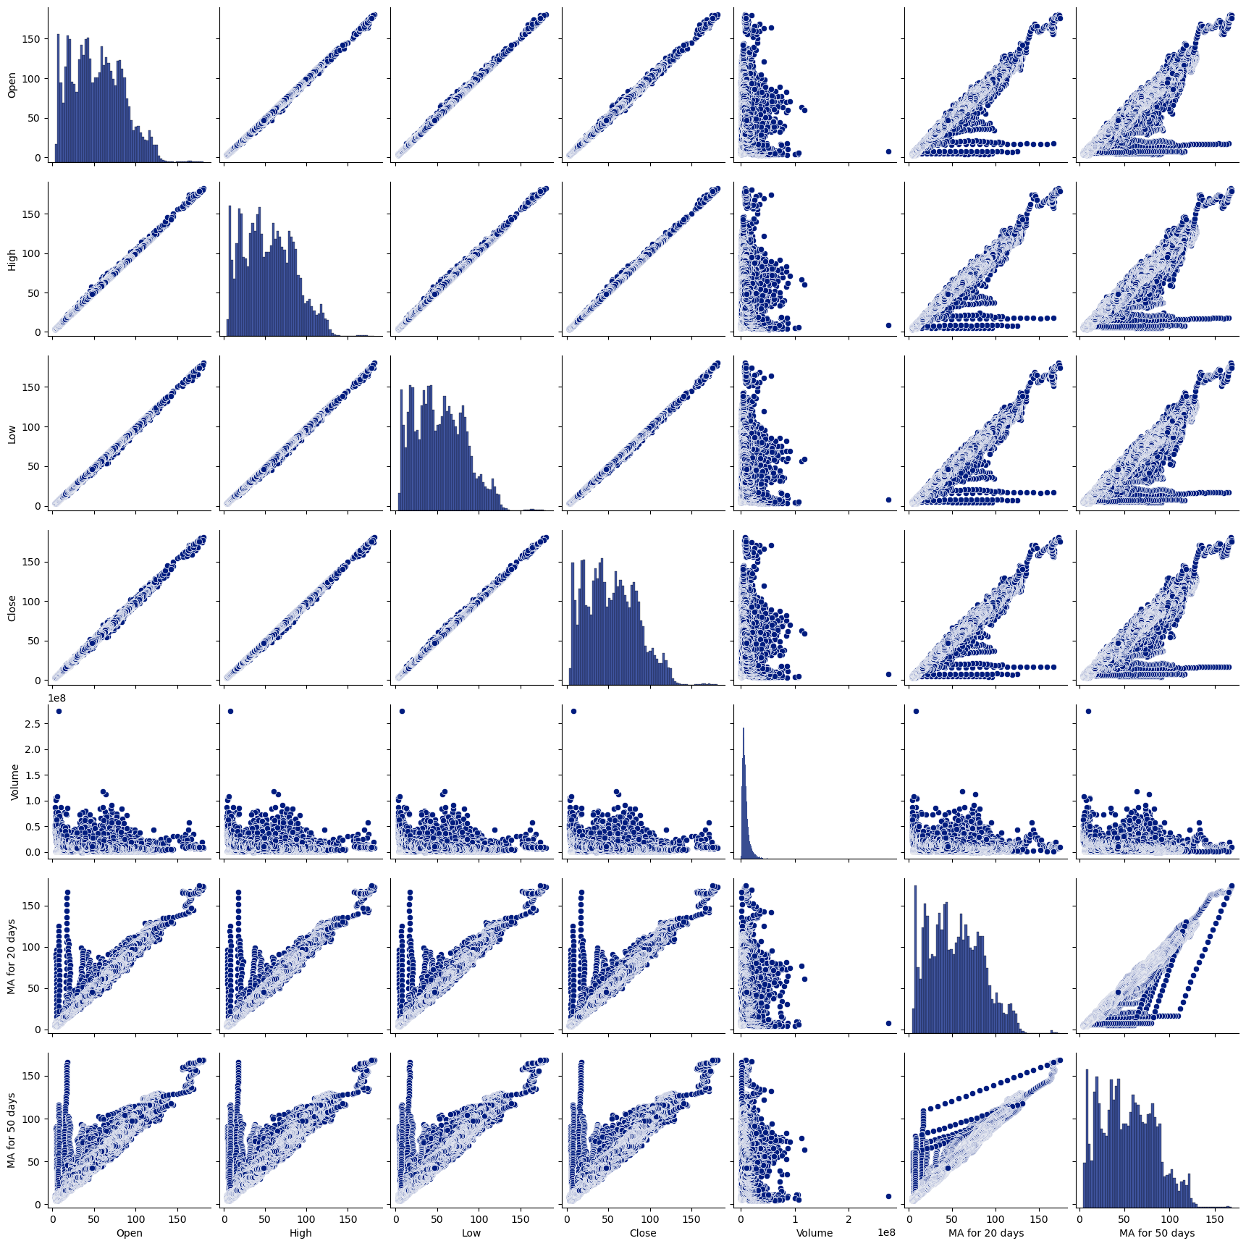
SUMMARY STATISTICS
Key Metrics:
Maximum Open Price: df [open ]. Max ()
Minimum Open Price: df[open ]. Min()
Insight: Provides a quick glance at the range of stock prices.

Slide 10
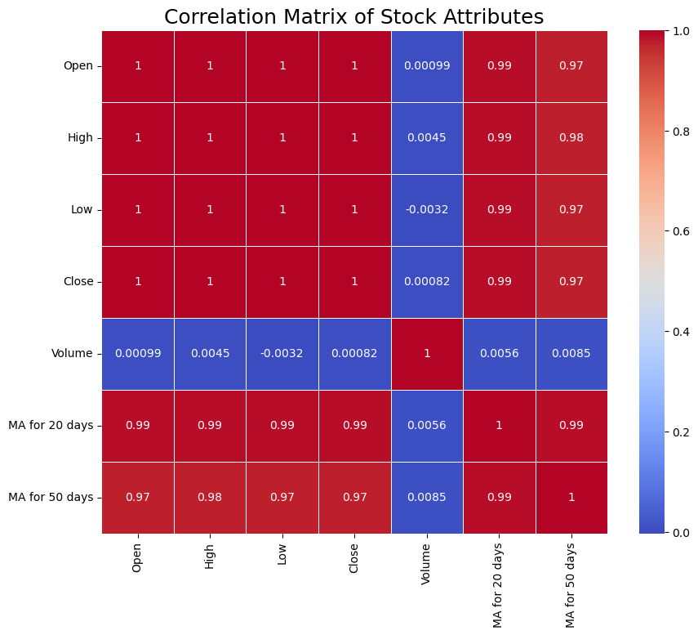
CORRELATION ANALYSIS HEATMAP
Correlation matrix of stock attributes.
Insight: Identified strong correlations between certain attributes, indicating multicollinearity.

Slide 11
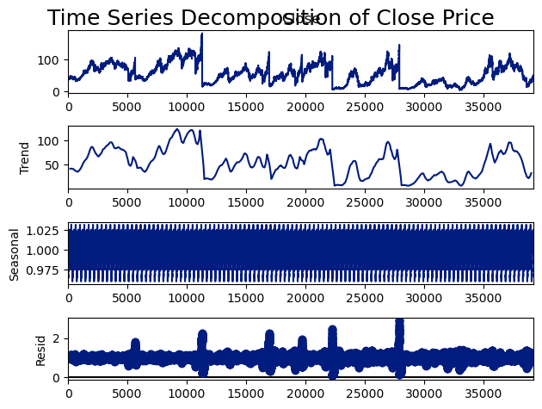
TIME SERIES ANALYSIS
Seasonal Decomposition:
Decomposed time series data into trend, seasonality, and residuals.
Insight: Seasonal patterns were identified, helping in understanding periodic behavior.

Slide 12
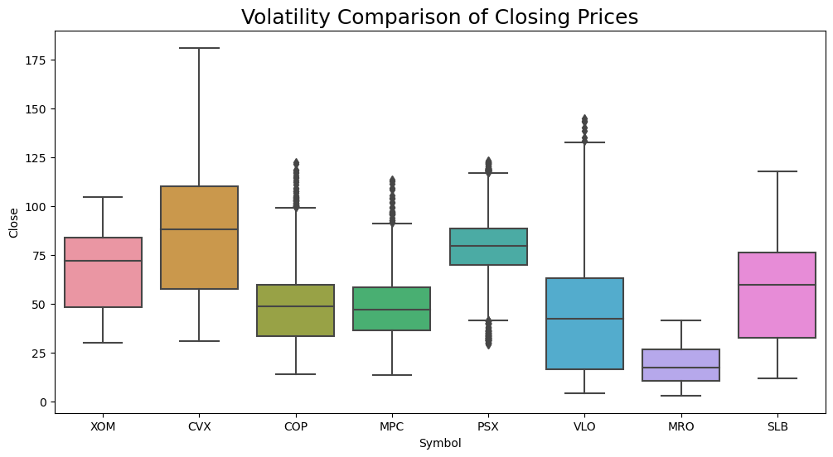
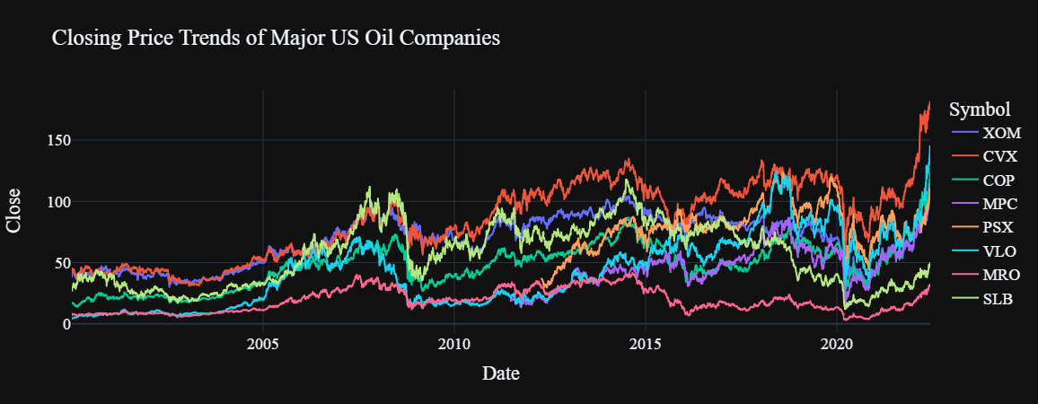
COMPARISON OF COMPANIES
Line Plot: Closing Price Trends across different companies.
Boxplot:
Volatility comparison of closing prices.
Insight: Highlighted the most stable and volatile companies.

Slide 13
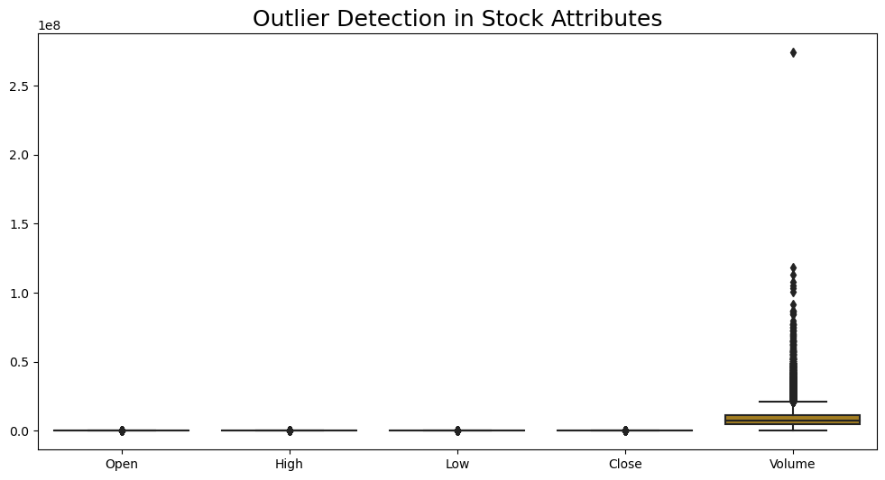
OUTLIER DETECTION
Boxplot: Identified outliers in stock attributes
Z-Scores:
Detected outliers using Z-scores.
Insight: Outliers were significant during market events.

Slide 14
INTERACTIVE DASHBOARDS
Dash App: Built an interactive dashboard using Dash.
Features:
Select different companies to compare stock prices interactively.
Benefit: Allows dynamic exploration of data by users.

Slide 15
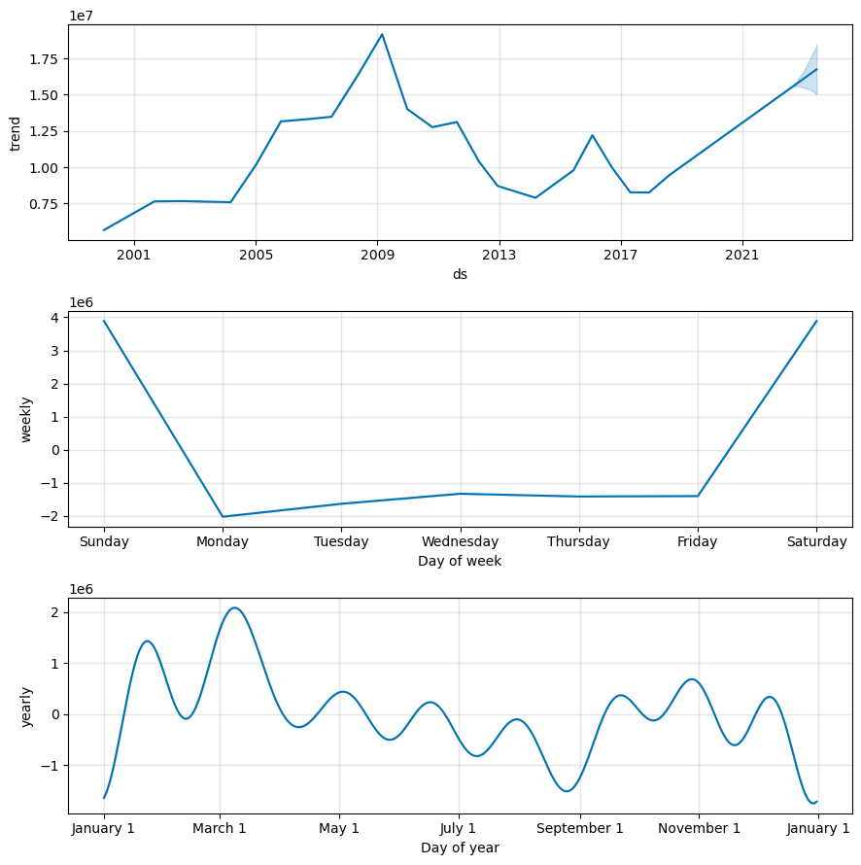
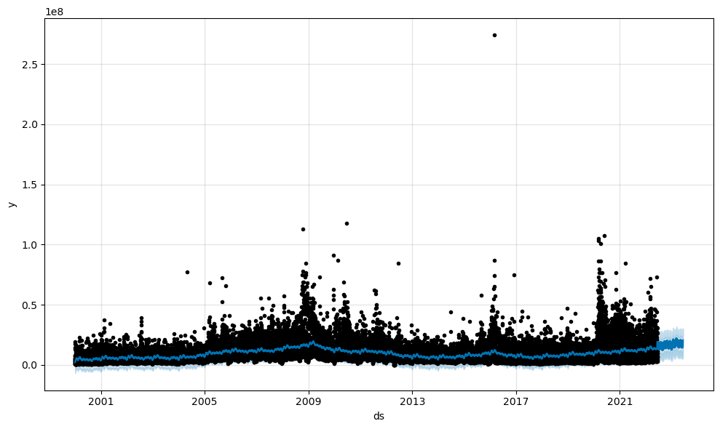
FUTURE PREDICTIONS
Prophet Model: Made future predictions of stock prices using the Prophet library.
Visualizations: Forecast plot and components.
Insight: Provided a forecast of future stock trends.

Slide 16
Conclusion
Key Take-ways:
Identified key trends, correlations, and potential outliers.
Compared stock price behavior across major companies.
Created predictive models for future stock prices.
Future Work:
Further analysis on specific market events.
Development of more advanced predictive models.

Slide 17
THANK YOU

